Slide 1







THE OVERALL CLASSIFICATION OF THIS BRIEF IS UNCLASSIFIED
Study Skills & Note Taking
OPR: 17 TRSS/TSF
POCs:
MSgt Jessica Bockelman
MSgt Valerie Baker-Wray
TSgt Willie Rouse
THE OVERALL CLASSIFICATION OF THIS BRIEF IS UNCLASSIFIED
Notes:
“Learning begins and ends outside the classroom” Col Thomas Coakley. What does this mean?
There are things you’ve done throughout your entire educational experience; some may help and some may not. I’m here to give you some tips and tricks for your new environment to help you grow.
In the last presentation, we went over what active learning is, and how important it is to have a growth mindset. How does this relate to study skills and note taking?

Slide 2




Outline
Study and Note Taking Habits
Where are you now?
Tips and Tricks
What are some effective habits?
Key Takeaways
What strategies can I implement
in my course?
Notes:
Before we begin, I need to understand who we have in the room and I would like to make you personally aware of your own study and note taking habits.
For each of the statements I am about to read, I would like you to raise your hand if this is a habit you already have.

Slide 3



I schedule definite times and outline specific goals for my study time
Notes:
(Adapted from UHCL)
Have students raise their hand if any of the statements apply to them.

Slide 4

I avoid activities which tend to interfere with my planned schedule

Slide 5

I study in a place free from auditory and visual distractions

Slide 6

I find that I can give undivided attention to study for at least 20 minutes

Slide 7

While I am taking notes I think about how I will use them later

Slide 8

I organize my notes in some meaningful way

Slide 9
When reading, I mark or underline parts I think are important

Slide 10
I try to imagine possible test questions while studying

Slide 11


Strengths & Areas for Growth
Notes:
Give students a sheet with room for them to write their strengths for studying and areas of growth. Give them time to share with a partner and then have 1 or 2 share with the largest group
Again, this was a self-awareness exercise. We’ve identified some areas that you’re good at, and some areas where you have an opportunity to grow.
How is this related to that we’ve already talked about? (fixed and growth mindsets)

Slide 12

Memory
Notes:
By a show of hands, who here has a good memory? Who has a poor memory? Well a growth mindset tells us that nobody is born with a “poor memory”. Memory is a skill, like any other, that can be improved upon. We will do a memory exercise to now to prove that point.
Split the room in two halves. Have one half close their eyes while the other half studies slide 13 for 20 seconds. Then switch. Have the other half study slide 14 for 20 seconds while the first half closes their eyes.
Now that each half has studied their slide, give the whole group about 30 seconds to write down as many of the units of information as they can recall from the slides.
Ask each group, one at a time, how many units of information they were able to write down. Compare the results of the two groups. Both groups were shown the same 12 units of information. So, why was group 2 able to recall more units of information than group 1? Reveal both slides to the whole group. Explain how the chunking of information on slide 14, shown to group 2, was easier for the brain to digest and commit to memory. Note that the brain is best able to deal with 4 chunks of information at a time. Remember this when you study. Arrange information in a logical way and group it into 4 chunks if possible.
This is just one strategy for recalling information but there are hundreds out there. Just google memory strategies and try and find a few that work for you.

Slide 13
Grapes
Chicken
Lettuce
Milk
Watermelon
Bacon
Cucumber
Cheese
Apples
Pork Chops
Celery
Eggs
Notes:
CHUNKING ACTIVITY GROUP 1

Slide 14
Fruits
Grapes
Apples
Watermelon
Vegetables
Celery
Lettuce
Cucumber
Meats
Chicken
Bacon
Pork Chops
Dairy
Eggs
Milk
Cheese
Notes:
CHUNKING ACTIVITY GROUP 2

Slide 15
Memory
Notes:
How does my understanding of memory make a more ready, more lethal Airmen? If we understand how memory works, we can understand how best teach our airmen the skills they need to be critical thinkers, to become SMEs, to be lifelong learners.
The first stage of memory is the sensory memory, which lasts 3-5 seconds. It takes that short amount of time for the brain to decide if the information it has encountered is important or not. If you don’t pay attention to it, it goes away quickly. If the brain deems it important it passes to the next stage of memory.
The second stage of memory is the short term memory. This length of time this stage of memory lasts is based on how often and complexly the information is utilized. If you don’t use the information, you lose it.
The third stage of memory is the long-term memory. Long-term memory is the most complexly encoded over longer periods of time with repeated use of the information.

Slide 16


Note Taking
Notes:
How many of you take purposeful notes?
Tell me what it means to take purposeful notes. (Organized in a meaningful way – main points, written in your own words, color coded, individual shorthand, etc.)
Why is it important to take purposeful notes?
Notes taken without purpose of not used. Purposeful notes help you to engage with the material. Purposeful notes are those that you will actually utilize in your study time.

Slide 17



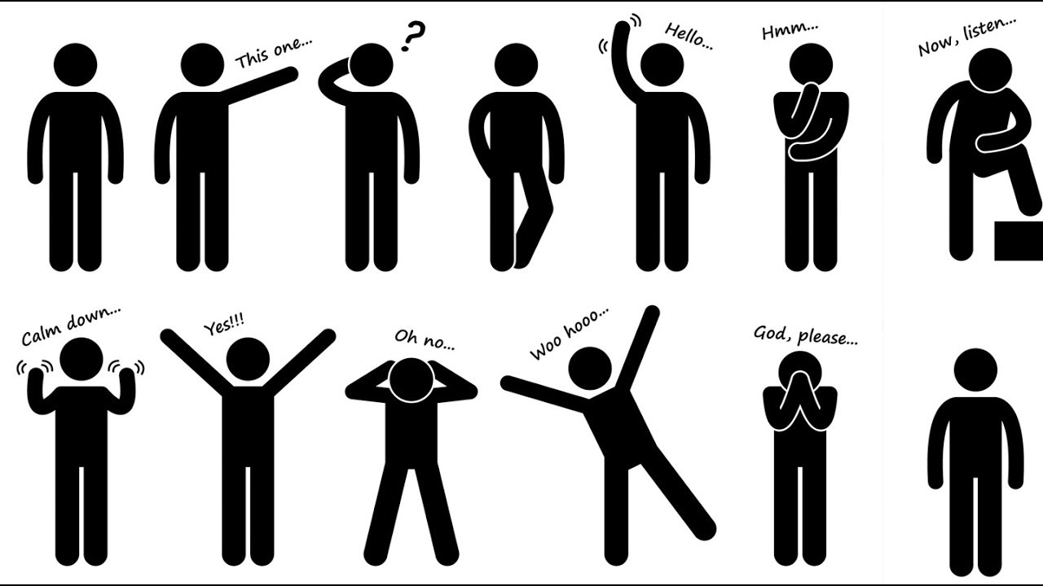
Listening: Cues
Notes:
How do we know what to take notes on?
Listen to the instructor’s voice; if their tempo changes, or they emphasize something or they repeat information…probably important. If they say it’s important…definitely important.
Visually; if you see items in a book, packet, or slide show that are bold or underlined then they are probably important. If you hear it AND see it, definitely important.
Body language; if the instructor becomes animated or emphatic in their body language, probably important.
Do not try and write EVERYTHING down. People speak at a rate of 3-5 words per second. You can’t keep up with that. Just write down what is important.

Slide 18

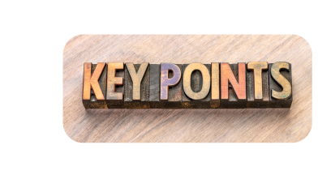


Listening
What is important?
What are the main points?
What is repeated?
What is related to yesterday’s lesson?
Notes:
These are the questions you want to ask yourself as you are listening to your instructor.

Slide 19

The Cornell Method
Cues
Why..?
How can…?
What is..?
Lecture Notes
Note One
Note Two
Note Three
Summary
Notes:
Who here has used the Cornell Method of notetaking?
1st section (right side of the page) is where you take your notes during a class or lecture. Make sure this section is written in your own words. Identify the main ideas and then add the details. Make sure you write legibly.
2nd section (left-hand margin), after the class or lecture, on your own time, go back and write down cues to organize the various sections of the notes. These could be keywords, vocab, questions, etc. Think of these cues as tabs that allow you to find specific info quickly without having to reread everything in order to find the one thing you are looking for.
3rd section (bottom of the page) is where you go back and summarize the lesson to create an overall picture. When we understand the overall meaning or gist of a lesson, the brain can then more easily go back and absorb the details.
Put notes in your own words
Ask questions
Use outline form
Identify the main ideas and then add the details
Note complete thoughts but simplify the notes
Don’t copy down word-for-word
Make sure you can read your notes
Write down or highlight difficult or new words/concepts
You can write the definitions close to them or look them up later
Consider developing your own “code”

Slide 20

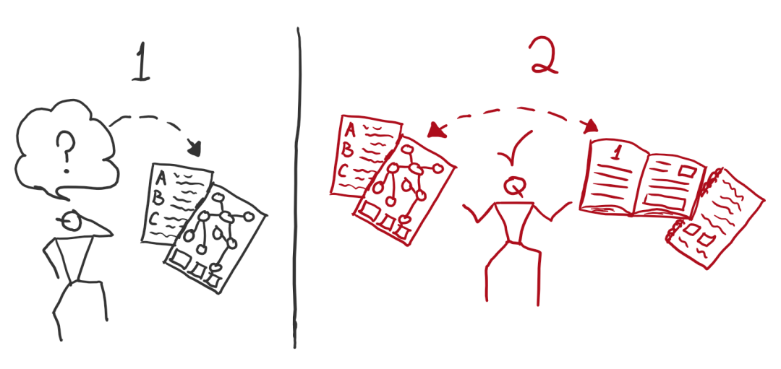
Retrieval vs. Re-Reading
Notes:
How many of you study by rereading your notes or textbooks?
The art of learning lies in retrieval of information from your brain, not in re-reading until you think it sticks. Rereading often gives the learner a false sense of confidence. Instead of rereading, try and use the retrieval method. This means writing down or reciting everything you think you know from a lesson. Once you have done this “retrieval” compare it to your notes or text. The items that you left out will identify learning gaps that you should then focus your study on. They only way to really know if you learned the information is to recall it without reference. Re-reading leads to false confidence.
Force yourself to pull information from memory and then check for accuracy using your notes and other content

Slide 21
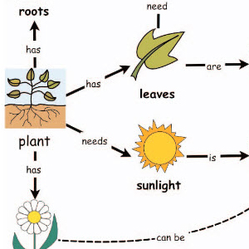
Study Strategies
Chunking
Read, Recite, Review
Active Reading
Gist Details
Flash Cards
Concept Maps
Flow Charts
Notes:
So, what are some strategies for committing information to long-term memory? How do we take our ability to recall information beyond the sensory level and put it into our working memory?
Read, Recite, Review: When you read something, try to recite it in your own words. If you are able to do this, then you’ve processed the information in your brain, made connections with what you already know, and were able to synthesize it into your own words. Then review to make sure that what you recited is in line with what you just read.
How many of you have been stuck reading the same line over and over again only to realize that you have no clue what you just read? If you adopt active reading techniques, you can mitigate that problem.
Gist before details: The brain has a better time absorbing the details of something when it understand the overall meaning and the why. For example I could explain the components and functions of an alternator and that would be difficult to understand if you didn’t already know where it fit in to the mechanics of a car. But, if I first explained that an alternator is the part of a car that provides power to the car’s electrical components, the alternator information would be more easily understood and thus easily remembered.
When studying:
Read all titles and headings what you are about to read or study so that your brain is primed for what you are about to read.
After each paragraph, verbally summarize what that paragraph is about.
Flash cards are a method of facilitating retrieval, which we already talked about. Use keywords on a flash card to cue yourself to recall as much as you can about whatever is written on the card and then compare what you were able to recall to your notes or text.
Concept Maps (aka Graphic Organizer) are a good way to build relationships between concepts and allow you to see how various components of an overall topic connect. Understanding these connections allow you understand the whole picture.
Use flow charts to memorize a process.
Example: CPR process medical protocol flow chart.
Some students have naturally found or developed cognitive strategies for themselves to help them study and appear as though they are gifted when really, they have just developed good habits. ALL students are capable of excelling.

Slide 22
Study Power Hour
Where and when will you study?
How will you recharge to manage your energy levels?
Begin Study Period
Set Study Target
2-5 min
What’s important now?
What is your target?
5
Break
15 min
1
How can you break down your target (study task)? What actions must you take to meet your target?
Establish Study Action
5 min
2
4
Review
15 min
How will you review what you’ve done?
Did you accomplish what you set out to?
What comes next?
Study with a Purpose
20 min
3
How are you studying with purpose? Is it clear to yourself what you are doing, and why you are doing it?
Notes:
MRT-PE Instructions:
Lecture from key points below.
Key Points:
* THIS SLIDE IS IN THE POWER STRATEGIES EDITION.
A good study routine is estimated to be about 50 minutes of time, followed by a short break. (This type of study capitalizes on primacy and recency effects.) You may find that you are more productive when you limit your study, as long as you have also taken precaution to minimize other distractions.
The Study Power Hour is designed to help you accomplish more in shorter, more intense periods of focused study time. It's useful because you can use the time to do any type of ACTIVE studying – taking notes while reading, organizing class and text notes, drawing diagrams, writing sample test questions, figuring out problems – during the hour. Just sitting at a desk in front of a book does NOT constitute studying.
To keep studying from getting monotonous, vary the focus and action during several of these power hours throughout the day.
Do Power Hours even if you don't have any homework. Even if you don't have anything due to your instructor, study each stay by reviewing.
How it works
How it works:
First, decide where and when you will study. This happens before your hour starts because a lot of time can be taken up finding a suitable time and place. D: appropriate study locations (intel vs fire).
Take 2-5 minutes to determine what is important now and what your target is. An excellent way to do this is practice the retrieval method earlier. This will let you know where you may need to focus your studies on most.
Take 5 minutes to establish a study actions. Will you write flash cards, concept maps, flow charts, outlines, or actively read?
Take 20 minutes to buckle down and do the work. No squirrels, hold your attention and focus for that full 20 minutes.
Take 15 minutes to review. This is the most important part. Why? This bolsters your memory. Focus on the areas that you are weakest in.
Take 15 minutes to go on a break. GO ON A BREAK. Step away from the material.

Slide 23
Summarize
Notes:
Ask the students to write down to things they will commit to using from this lesson in their own study habits. (AV) Play video while they are completing this exercise. (Observe how students are reacting to this distraction!)

Slide 24

Notes:
Embedded video
Who remembers the task before the video?
How much did you write down during the video?

Slide 25
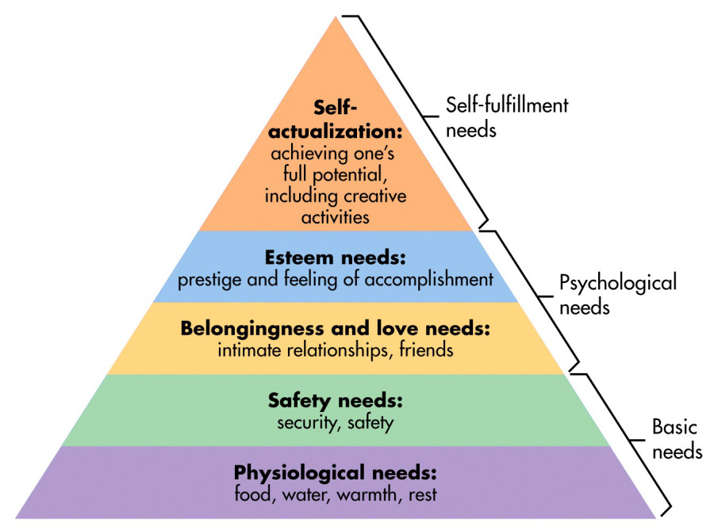
Dealing With Distractions
Deal with physiological needs first
Netflix
Be a spider
*Listen to music*
Avoid loud or lyrics
Roommates
Cell phones
Notes:
Who has heard of Maslow’s Hierarchy of Needs?
Can you please explain it?
It’s hard to focus when you are hungry or cold, or super tired. If you can’t stay awake, you’re not going to learn anything. Take a 20 or 90 minute power nap. Eat some food. Your brain takes only 3% of your body weight, but it takes 25% of your energy….feed it! It runs on glucose, it needs it to function at peak performance. If you are too worried about a family issue back home or if your significant other is mad at you, you won’t be as efficient as you can be. Take care of those needs first as best you can. Just know, you HAVE to study at some point.
No Netflix…we just demonstrated that you can’t play a video and take notes at the same time. It is cognitively impossible to multitask two cognitive functions at 100%.
What happens when a fly lands on a spider’s web?
The spider knows it’s not going anywhere, so it takes it’s time getting to it. Barring any emergencies, unexpected distractions are not going anywhere. Set them aside during your study time and focus. You can always come back to them later. This means NO CELL PHONES!
Who here gets distracted when you hear a key word in your background, or someone says something in another room? Listening to music can have the same effect. If you must listen to music, choose music that is without lyrics and listen to it quietly.
How do you deal with studying in an environment where you are three to a room in a room designed for two to a room?

Slide 26
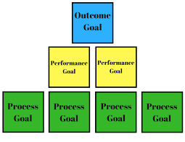

SMART Goals
Notes:
Who has worked with a SMART Goal before?
What is their purpose? (to keep focused and motivated)

Slide 27

Takeaways
Learning begins and ends outside of the classroom
Notes:
We just covered study skills and note taking habits, tips, and tricks to learning information.
Do a brief Think-Pair-Share for takeaways from study skills
Write down one key takeaway from this lesson. Share that takeaway with a partner.
What are some takeaways that you have?
Through the active learning environment, the students will graduate with not only the foundational knowledge of their AFS, but also the soft skills needed to operate in ambiguity – identifying knowledge gaps, knowing how to fill those gaps, and how to mentor those around them with that knowledge. Those soft skills translate to the operational field by not only helping airmen attain and maintain a high level of technical readiness, but also lay the foundation to build exceptional leaders.
These lectures have given you the opportunity to think critically about the information and communicate your thoughts effectively with peers and facilitators – two skills necessary not only for academic success, but also operational success.

